Slide 1




Measurement of the Earth’s Magnetic Field on a High-Altitude Balloon
Students: Trevor Towers, Anthony Smith, Amorette Dudgeon
Mentor: Mike Sampogna, Physics Dept., Pima Community College Northwest
Statewide Symposium - Tucson, Arizona - April 16th, 2016
Notes:
1 minute per slide means 7 slides

Slide 2
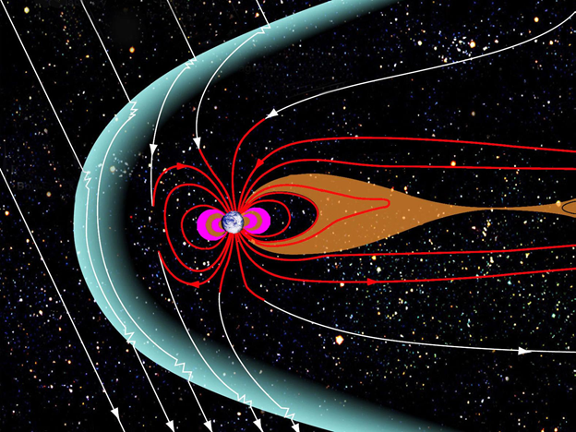
Objective & Motivation
Deploy a sensor to effectively measure the Earth’s magnetic field using an absolute orientation sensor and compare these results to already published data by the National Oceanic and Atmospheric Administration
Conduct the experiment in accordance to NASA/ASCEND/ANSR guidelines, while improving upon last semesters design, with new equipment that should net superior results
The magnetosphere generated by the magnetic field. [1]

Slide 3
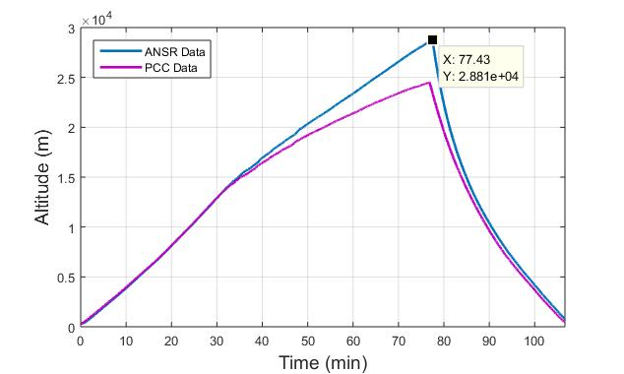
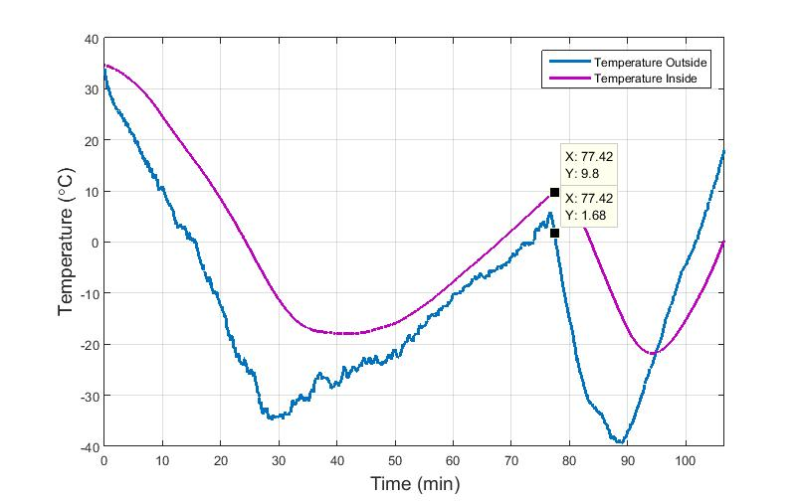
review of design & Spring flight
Fall 2015
  Adafruit 3-Axis Accelerometer & Magnetometer (LSM303DLHC) [2]
  Primary concerns: noise, data refinement
Spring 2016
  Adafruit Absolute Orientation Sensor (BNO055) [3]
  Isolated EM payload from cameras
1) The altitude data versus time, from ANSR, due to the payload’s GPS inaccuracy. 2) The temperature, inside and outside, as a function of time.

Slide 4
Comparison between semesters
The raw magnetic field strength data, as magnitude, from fall 2015.
The raw magnetic field strength data, as magnitude, from spring 2015.

Slide 5
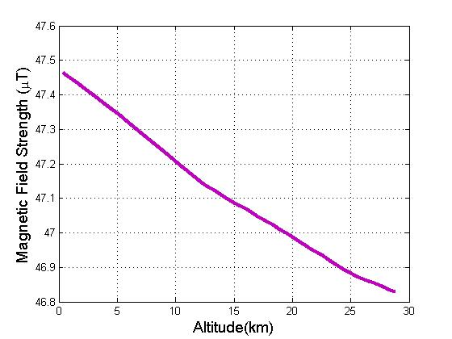
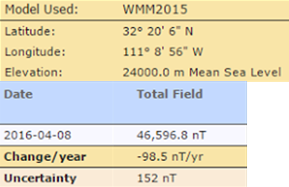
Comparison to published values
The published values for the launch site based on the IGRF Model. [4]
The expected decrease of the magnetic field strength, according to ANSR’s data.
Notes:
Changes:
Replaced previous figure with the IGRF expected values based on Jack’s data.
-kept it yellow for consistency
Figure is highly linear and horizontal after considering the scale factors

Slide 6
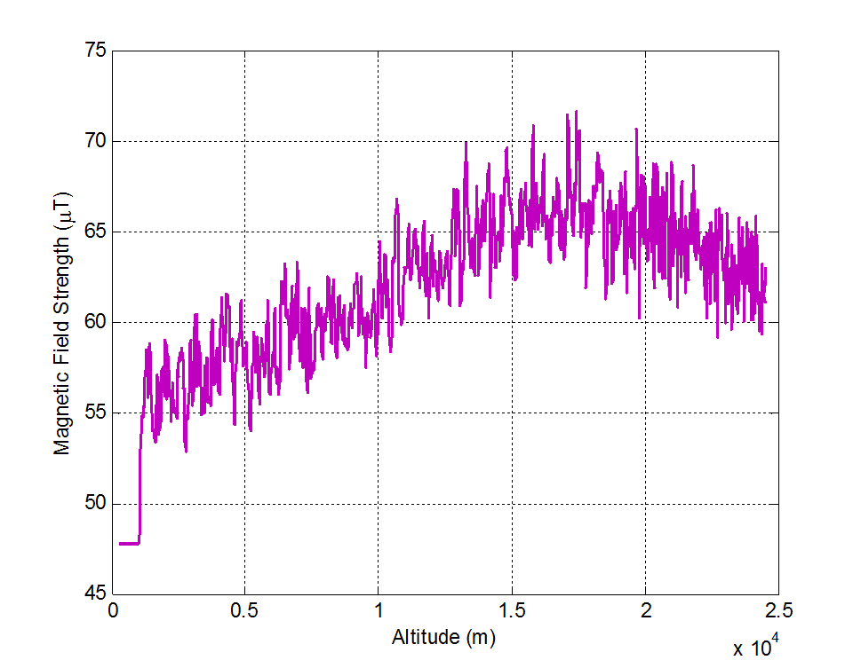
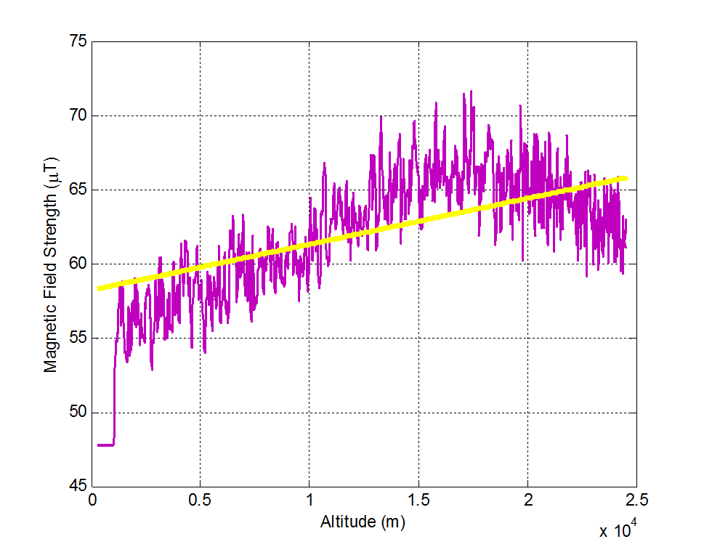
Analysis strategies: Low Pass Filtering
1) The raw magnetic field strength data. 2) The data after a low pass filter. 3) The filtered data shown with a best fit line.
Notes:
Low pass filtering is the only one worth talking about. ( I can explain later)
Can we do an animation in this order?:
Raw unfiltered data
Filtered data
Filtered with best line fit
This sequence should grant us enough talking points to use all of our time.

Slide 7
Conclusion
Successes
Limitations
New sensor in the spring was an improvement over last semester, as shown by the magnitude of the magnetic field strength
Better understanding and usage of MATLAB and it’s potential for faster and more in-depth data analysis
The GPS data was not accurate and this affected the latitude, longitude, and altitude data
Stability of the payload is a concern; this experiment would be ideal in a stationary system
Potential in finding further filters and statistical methods to refine & analyze the data

Slide 8
Thank you!
Questions?

Slide 9
References
[1] NASA, "Earth's Magnetosphere and Plasmasheet," 22 January 2013. [Online]. Available: http://www.nasa.gov/mission_pages/sunearth/science/magnetosphere2.html. [Accessed 10 April 2016].
[2] Adafruit, "LSM303DLHC Data Sheet," 2016. [Online]. Available: https://cdn- shop.adafruit.com/datasheets/LSM303DLHC.PDF. [Accessed 15 October 2015].
[3] Adafruit, "BNO055 Intelligent 9-axis absolute orientation sensor," 2016. [Online]. Available: https://www.adafruit.com/datasheets/BST_BNO055_DS000_12.pdf. [Accessed 15 January 2016].
[4] National Oceanic and Atmospheric Administration, "Magnetic Field Calculators," 2014. [Online]. Available: http://www.ngdc.noaa.gov/geomag-web/?useFullSite=true. [Accessed 15 October 2015].

